Slide 1
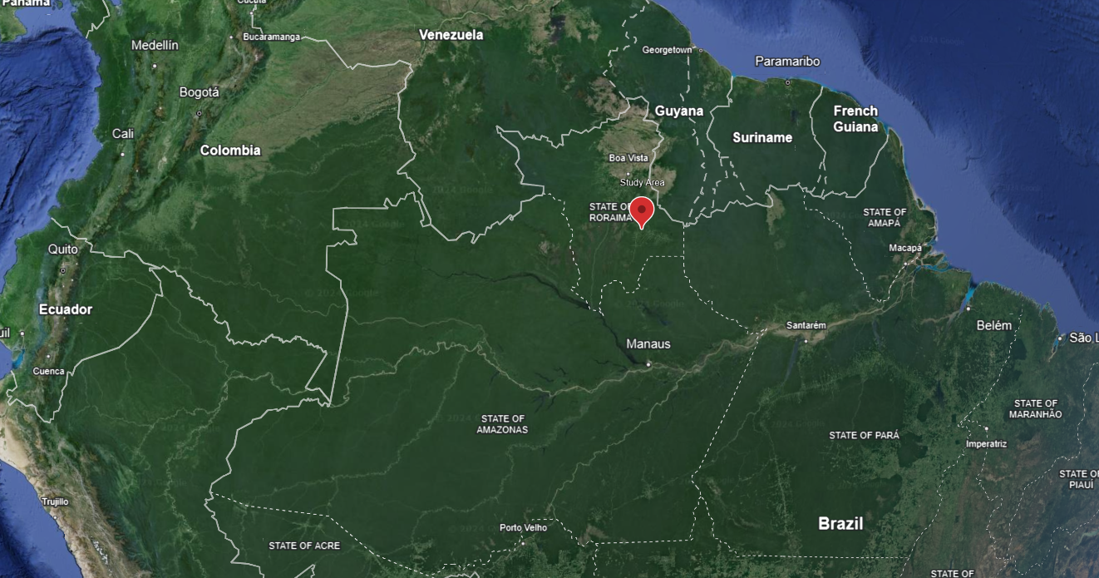
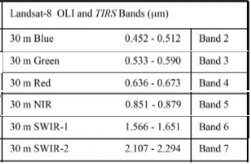
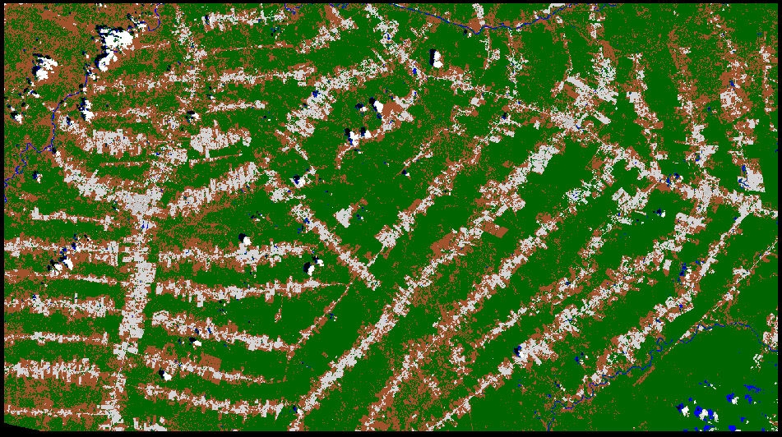
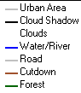
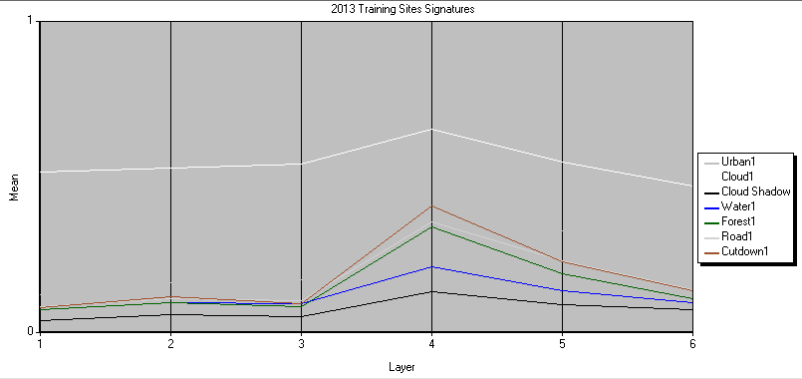
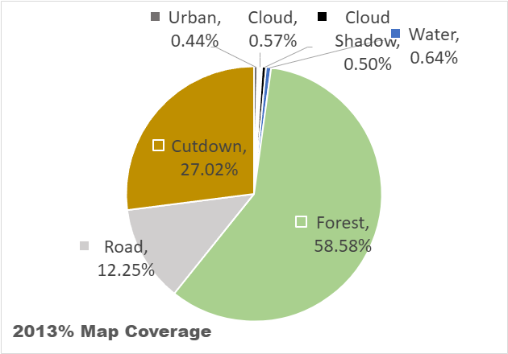
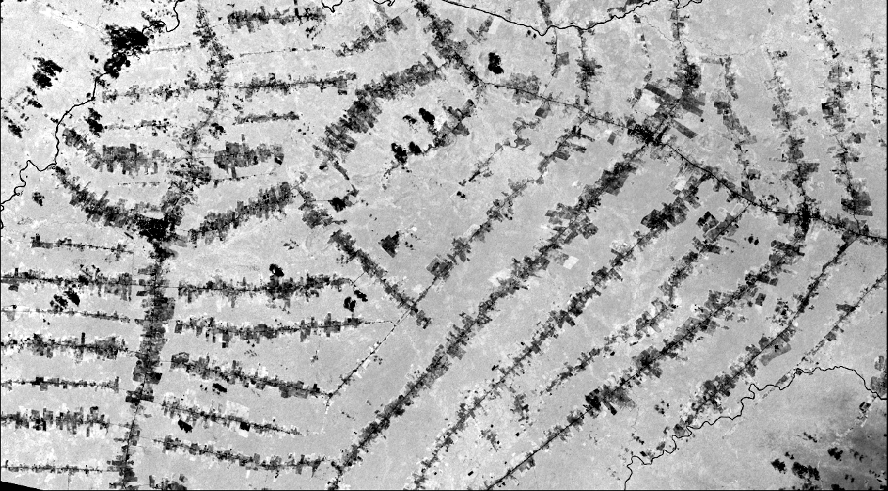
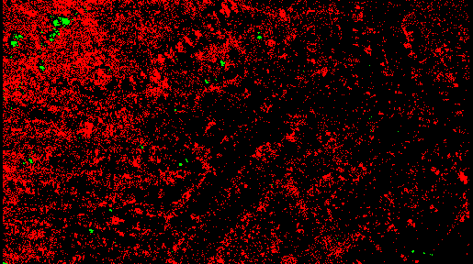
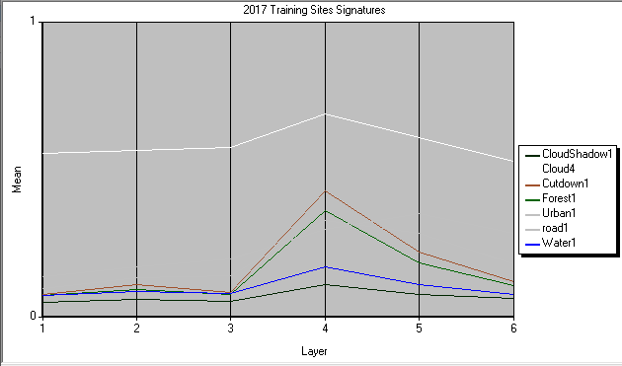
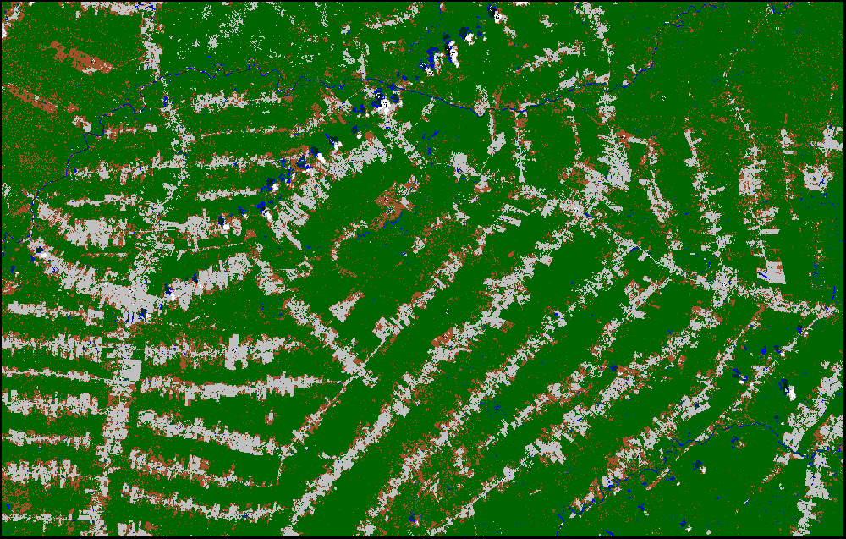
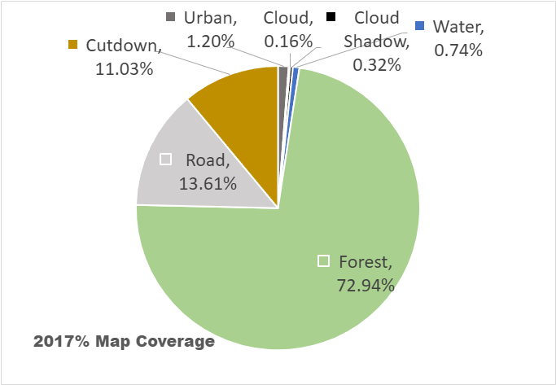
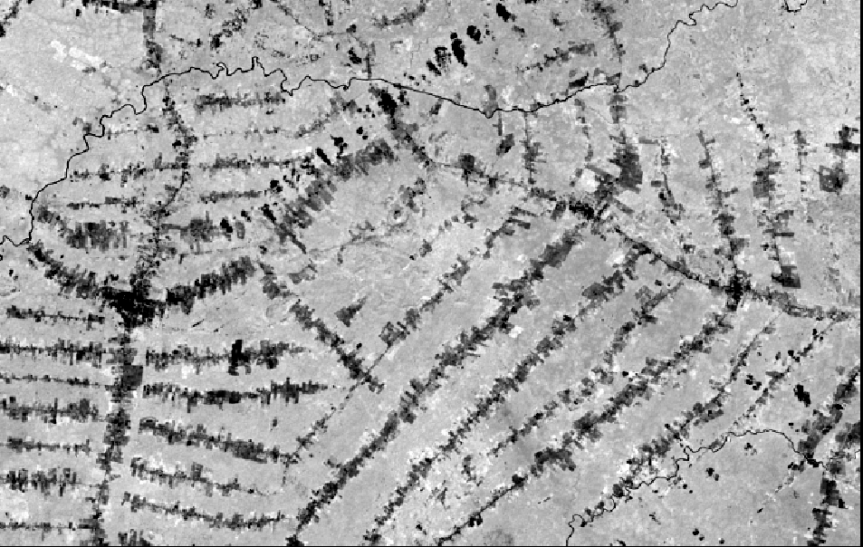
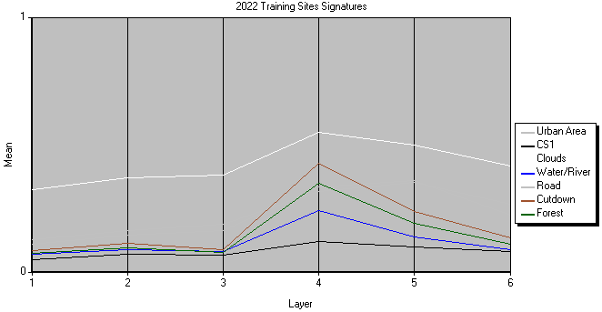
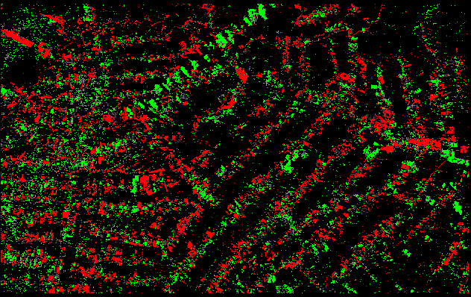
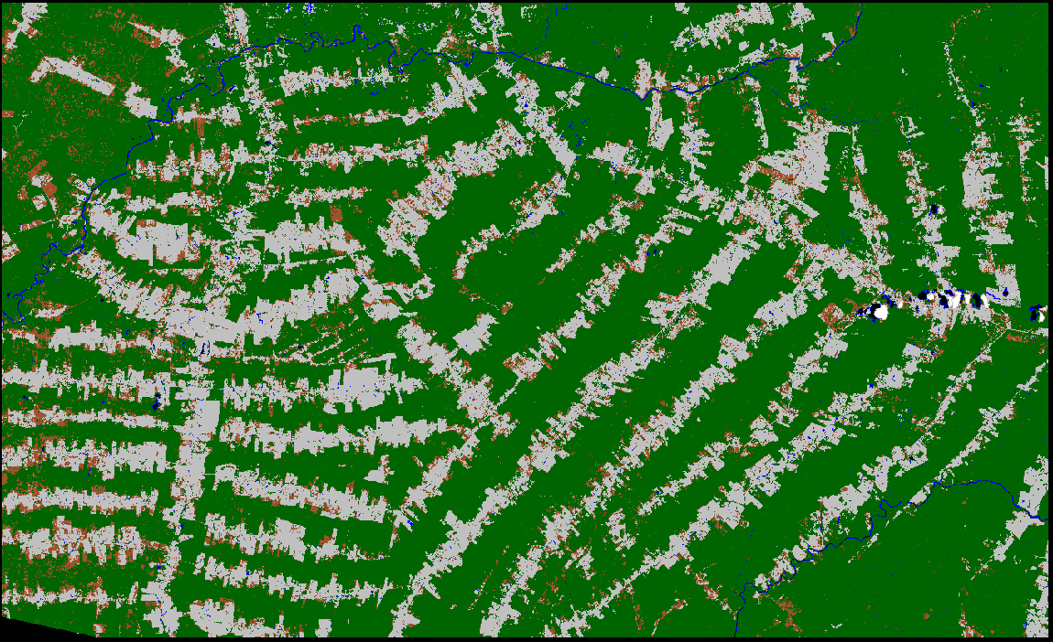
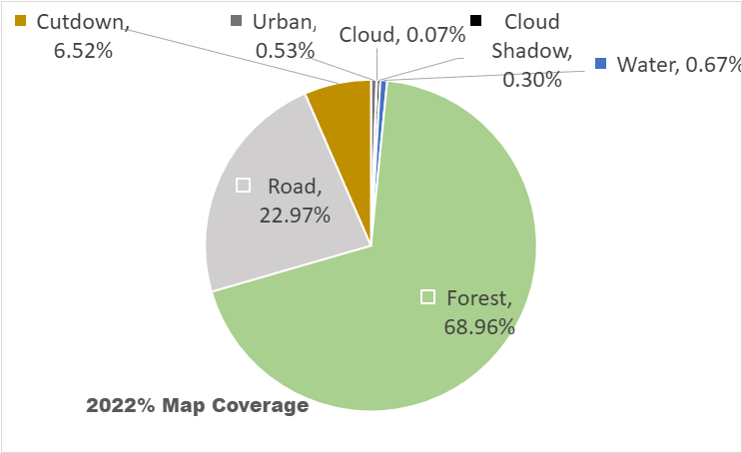
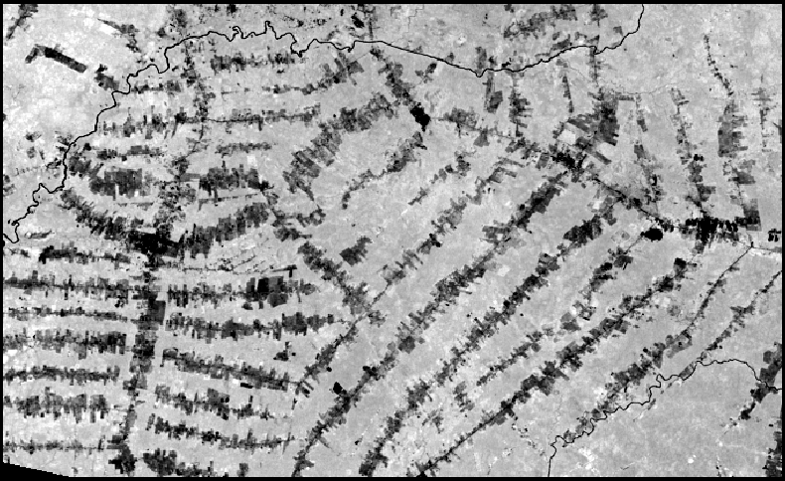
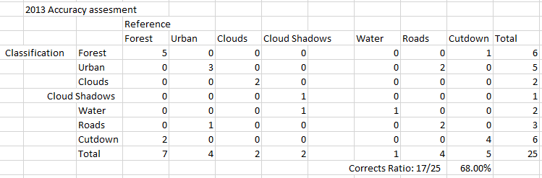
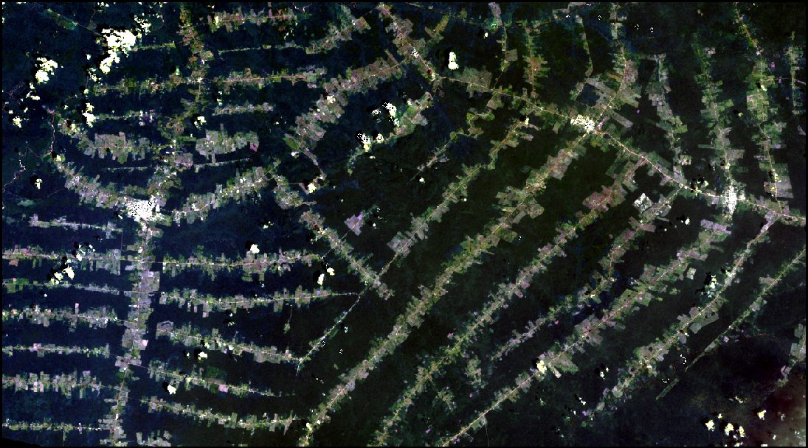
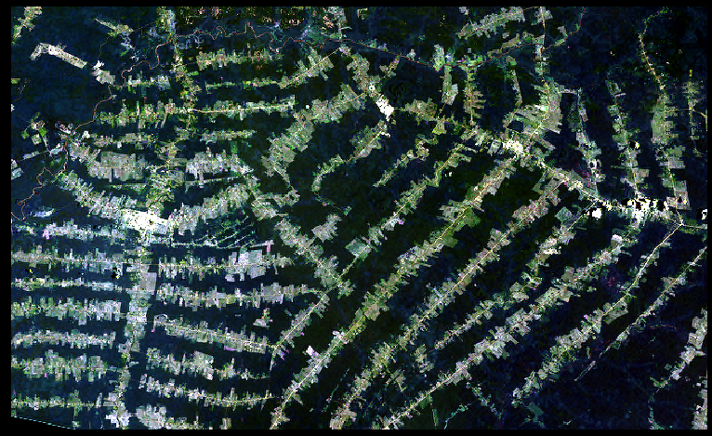
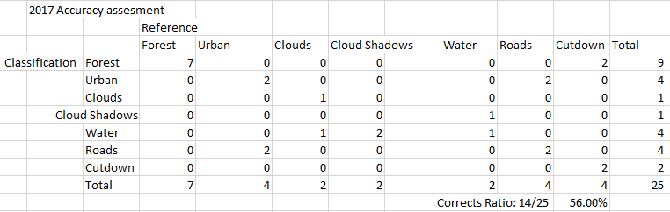
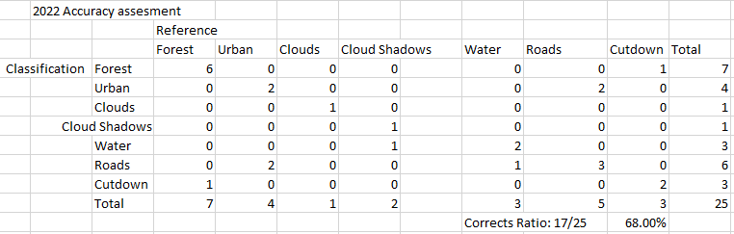
Brazilian Amazon Land Change Analysis 2013-2022
Alex Hudak,Vichakshan Maturu, Anish Jayewardene
Project Objective/ Study Area
This study investigates deforestation patterns within the Brazilian Amazon rainforest, a region historically dominated by dense tropical forests. We aim to quantify the extent of forest loss attributable to the development of settlements. Throughout the Amazon, vast areas once cloaked in lush vegetation have been converted to bare land or utilized for agriculture. Our research focuses on a 4,000 square kilometer area primarily consisting of agricultural land, situated amidst the rainforest north of Manaus. We employed Landsat 7 ETM+ and Landsat 8 OLI satellite imagery acquired in May of 2013, 2017, and 2022. Specifically, bands 2-7 (blue, green, red, near-infrared, SWIR1, and SWIR2) were utilized for analysis. Given the vastness of the region, we strategically cropped our image data to encompass the area north of Manaus along Highway 174. This specific area falls within the vicinity of the towns Vila Nova Paraíso, São Luiz, São João da Baliza, and Rorainópolis.
Remote Sensing Data
The data used in this study is Level 2 data obtained from the USGS explorer site which was acquired by the Landsat 7 and Landsat 8 satellites orbiting the planet at 705 km. The data was gathered using both ETM+ and OLI instruments on both platforms respectively. Leveraging Level 2 remote sensing data offers significant advantages for scientific analysis. These data products are pre-processed to include atmospheric corrections, eliminating the need for applying radiometric correction formulas like those involving conversion to TOA reflectance. This translates directly to a streamlined workflow, bypassing time-consuming pre-processing steps. The standardized reflectance values within Level 2 data, often presented in units like TOA reflectance, ensure data consistency and facilitate seamless comparison across various sensors. This allowed us to directly focus on scientific inquiries and increased our confidence in the data's quality and suitability for multi-sensor analysis.
Image Classification To gain a deeper understanding and visualization of the study area, we performed a supervised classification using the minimum distance algorithm. We opted for this method over maximum likelihood due to its superior precision in our case. When we employed maximum likelihood, the output deviated significantly from our expectations, with most areas classified as water or urban, which contradicted reality. We established seven distinct classes for the classification: water, clouds, cloud shadows, urban areas, roads, cutdown areas (deforested land), and forest. For each class, we carefully selected training sites: four for clouds, cloud shadows, water, and urban areas, and two for forests and roads. This resulted in approximately 28 training sites for the 2013 data, 26 for 2017, and 35 for 2022. Leveraging these training sites, we were able to group image pixels into the seven designated classes, generating a supervised classification map. This map significantly enhanced our ability to visualize the landscape and identify the impacts of deforestation and urban sprawl within the Amazon region from May 2013 to May 2022.
Signature Mean Statistics
These are the signatures for our training sites.They are graphs showing the relationship between the bands(layers) and the average reflectance values of the layer (mean).
2013
Legend:
NDVI Analysis
The Normalized Difference Vegetation Index (NDVI) is a valuable tool for assessing vegetation health. It utilizes the near-infrared and red wavelengths, as healthy vegetation reflects more infrared light than red light. The NDVI formula is: NDVI = (pNIR - pRED) / (pNIR + pRED). To better visualize changes in vegetation cover between images, we adjusted the percent difference thresholds. For the 2017-2022 map, a 10% change was used, while a 1% change was used for the 2013-2017 map (increased sensitivity for earlier, potentially subtler changes). Green areas on the NDVI maps represent areas of vegetation growth, while red areas indicate deforestation.Our analysis reveals a significant increase in deforestation from 2013 to 2017, with minimal evidence of vegetation growth during this period. However, the comparison between 2017 and 2022 shows a promising shift: deforestation appears to have slowed down, accompanied by signs of increased vegetation regrowth.
2013 NDVI
2017 NDVI
2022 NDVI
Land Usage Graphs
2017
2013 →2017 (NDVI Change Analysis)
2022
2017 → 2022 (NDVI Change Analysis)
Accuracy Assessment
To validate our supervised classification, we compared results with reference images from Google Earth Pro (25 points per year across 2013, 2017, 2022 images). Overall accuracy was 68% in 2013, decreasing to 56% in 2017, before recovering to 68% in 2022. Spectral similarities between cloud shadows/water, forest edges/cutdown areas, and roads/settlements posed the biggest challenges.
Conclusion
Employing remote sensing techniques, this study investigated deforestation patterns within a designated "fish-bone" region of the Brazilian Amazon rainforest. The primary objectives were to identify areas exhibiting deforestation, quantify the extent of deforested land, and analyze land-use changes over a specified timeframe (2013-2022). The initial stage involved image enhancement to facilitate the differentiation of various landscape features, primarily vegetation, urban areas, and agricultural land.
Comparative analysis of the classified vegetation areas revealed a significant decline in forest cover from 2013 to 2017, accompanied by an increase in exposed soil and agricultural land. This confirmed the occurrence of large-scale deforestation within the designated study area. However, between 2017 and 2022, significant deforestation continued within and around the "fish-bone" area, alongside signs of forest regrowth in certain areas.
March 2013 True Color Composite
March 2022 True Color Composite

